Slide 1

Login Page
Username:
Passwrod:

Slide 2
Enter Project Code
Project Code

Slide 3
You have participated the scheduling of Project Moudle GEM 20000 step 1: import your schedule from IVLE/Google Calendar
upload

Slide 4
Step 2: add other unavailable slots
9:34 medical appointments
 | 8:00 | 9:00 | 10:00 | 11:00 | 12:00 | 13:00 | 14:00 | 15:00 | 16:00 | 17:00 | 18:00 | 19:00
Mon
Tues
Wed
Thur
Fri
Sat
Sun

Slide 5
Step 3: rank prority
Are there any other events that you would like to rank above the project discussed thereof?
Really urgent and important stuff
Something I am willing to postone

Slide 6
RESULTS!
The computer has indicated these preferential slots for you!
 | 8:00 | 9:00 | 10:00 | 11:00 | 12:00 | 13:00 | 14:00 | 15:00 | 16:00 | 17:00 | 18:00 | 19:00
Mon
Tues
Wed
Thur
Fri
Sat
Sun

Slide 7
Coordination
Hey can we not meet on Monday ’cos I’m not
feeling well :(
Shall we have a poll?
Type Something…

Slide 8
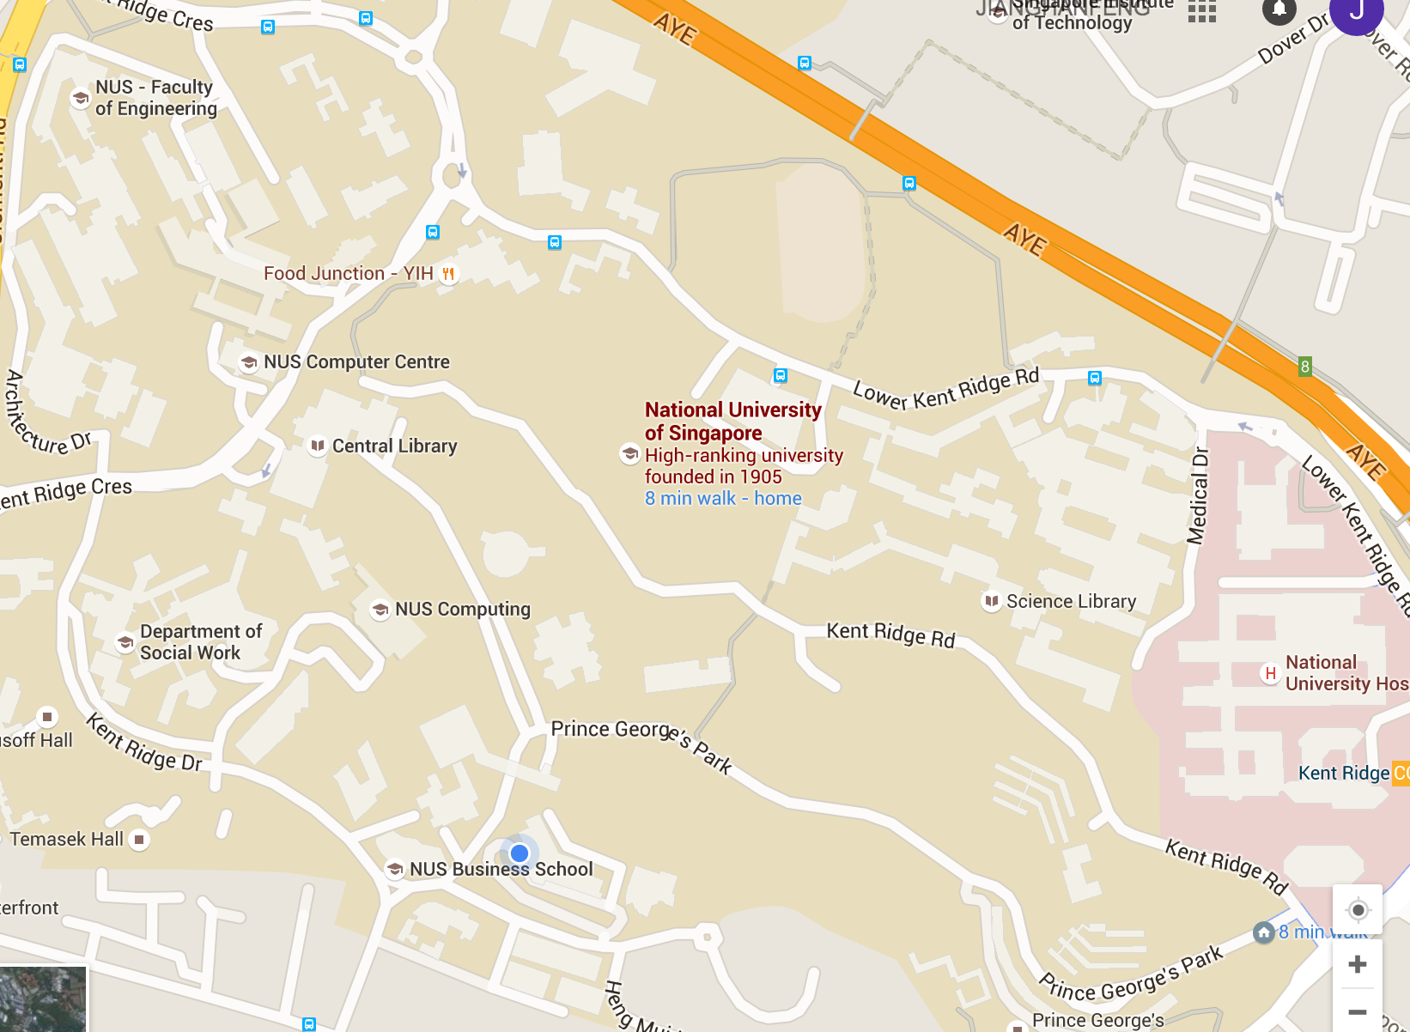
Indicate preferential Venue
I would like to
Meet around
computing

